Slide 1
Teasel Removal Guidelines
Long Grove Conservancy and Scenic Corridor Committee (r2)

Slide 2
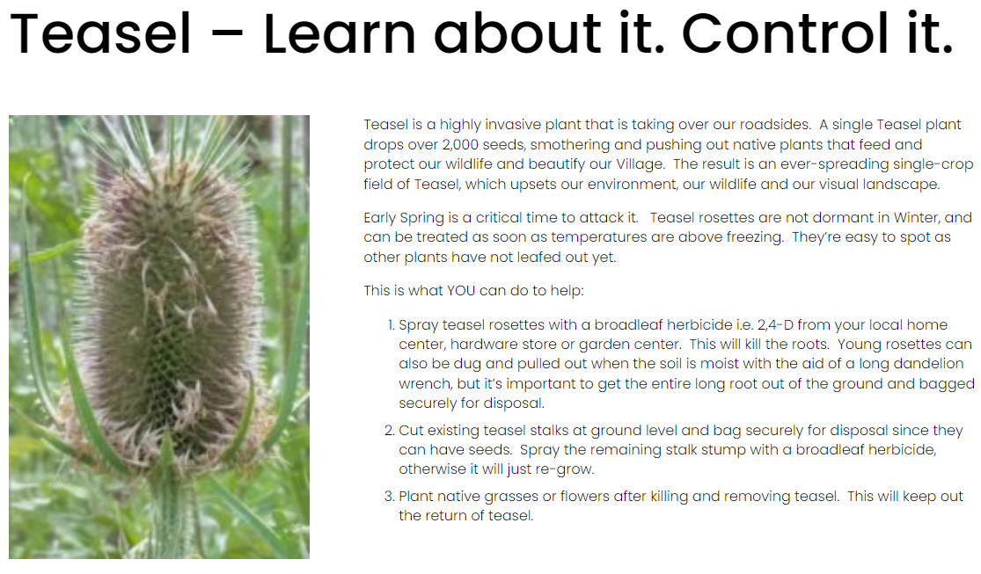
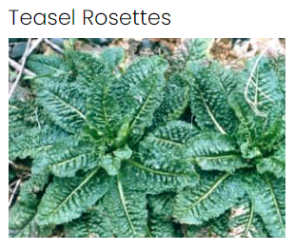
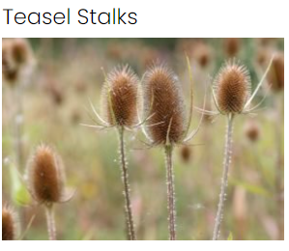
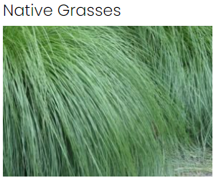
Teasel – Learn About It, Control It (VOLG Park District) Link: https://www.lgparks.org/teasel

Slide 3
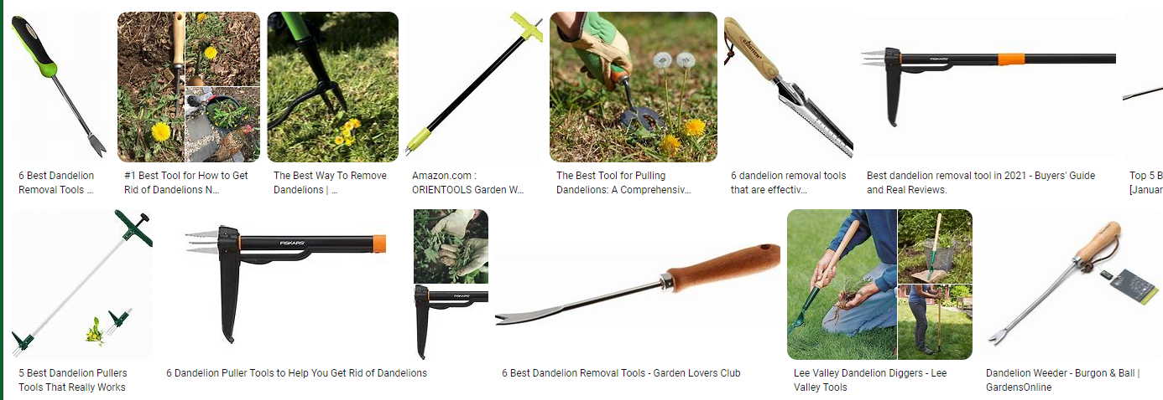
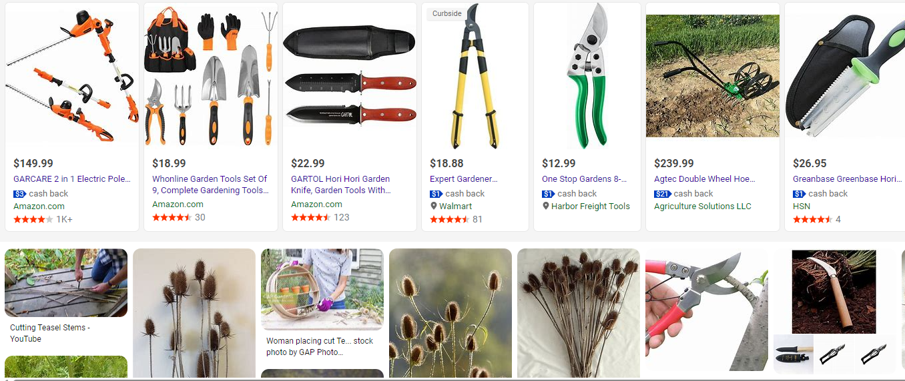
Examples of Dandelion Pullers & Garden Tools – for digging out & pulling out Teasel Rosettes & cutting Teasel Stalks Link: https://www.bing.com/images/search?q=dandelion+wrench&qpvt=dandelion+wrench&form=IQFRML&first=1

Slide 4
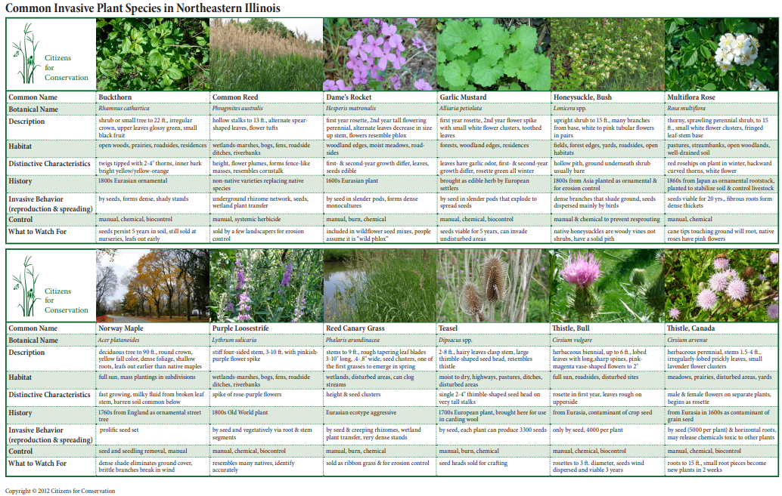
Common Invasive Plant Species in Northeastern Illinois (Citizens for Conservation) Link: https://citizensforconservation.org/wp-content/uploads/2014/08/Common-Invasives-in-NE-IL-Poster.pdf

Slide 5
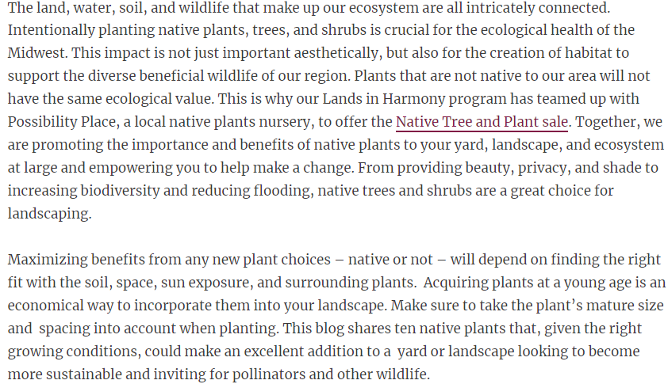
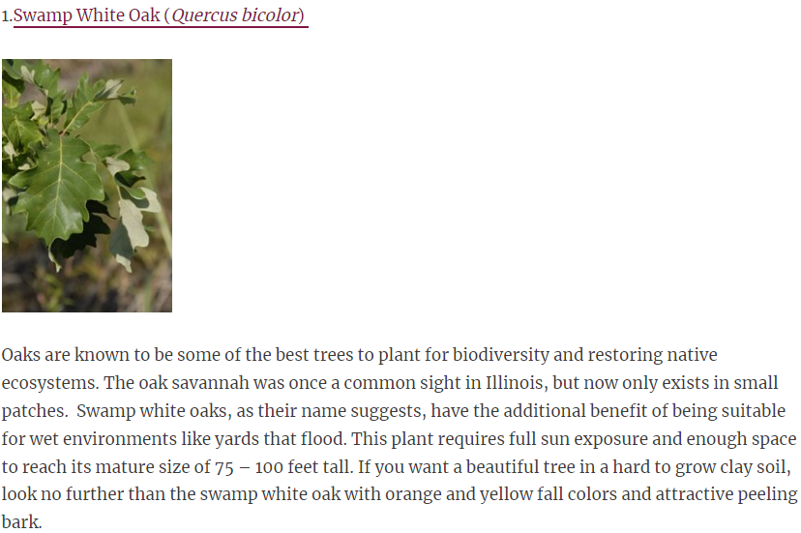
Openlands – 10 Native Trees and Shrubs for Landscaping in the Midwest Link: 10 Native Trees and Shrubs for Landscaping in the Midwest | Openlands

Slide 6
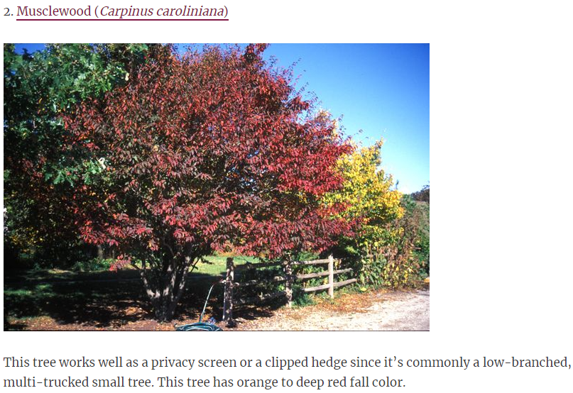
Openlands – 10 Native Trees and Shrubs for Landscaping in the Midwest Link: 10 Native Trees and Shrubs for Landscaping in the Midwest | Openlands

Slide 7
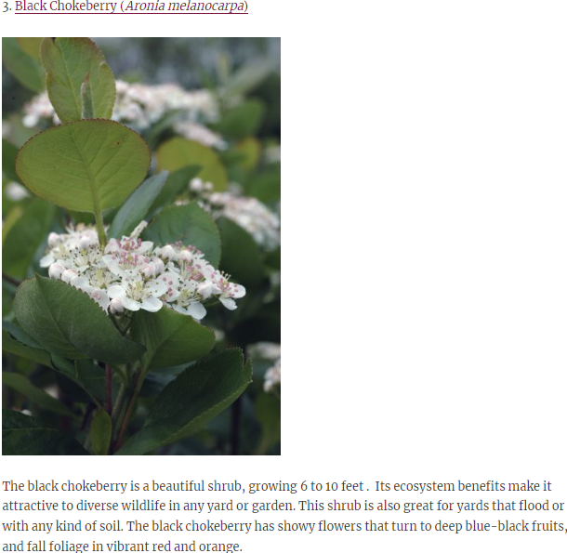
Openlands – 10 Native Trees and Shrubs for Landscaping in the Midwest Link: 10 Native Trees and Shrubs for Landscaping in the Midwest | Openlands

Slide 8
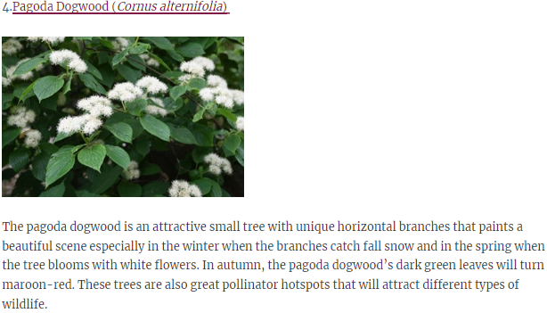
Openlands – 10 Native Trees and Shrubs for Landscaping in the Midwest Link: 10 Native Trees and Shrubs for Landscaping in the Midwest | Openlands

Slide 9
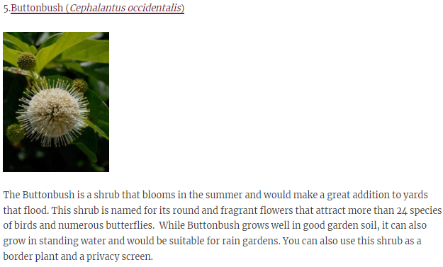
Openlands – 10 Native Trees and Shrubs for Landscaping in the Midwest Link: 10 Native Trees and Shrubs for Landscaping in the Midwest | Openlands

Slide 10
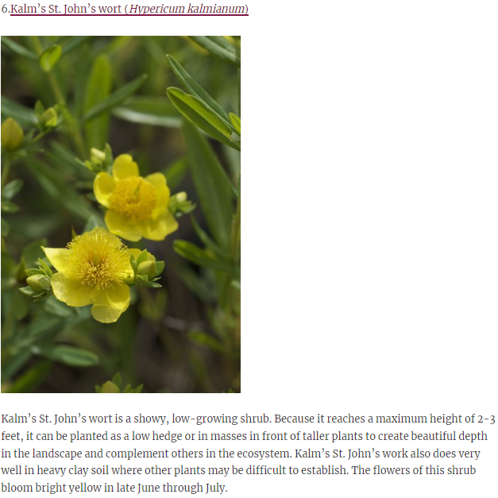
Openlands – 10 Native Trees and Shrubs for Landscaping in the Midwest Link: 10 Native Trees and Shrubs for Landscaping in the Midwest | Openlands

Slide 11
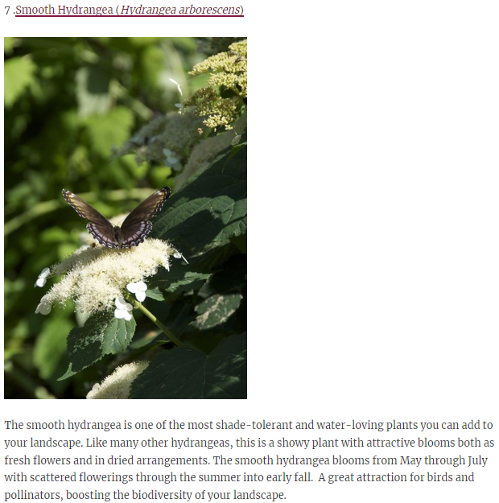
Openlands – 10 Native Trees and Shrubs for Landscaping in the Midwest Link: 10 Native Trees and Shrubs for Landscaping in the Midwest | Openlands

Slide 12
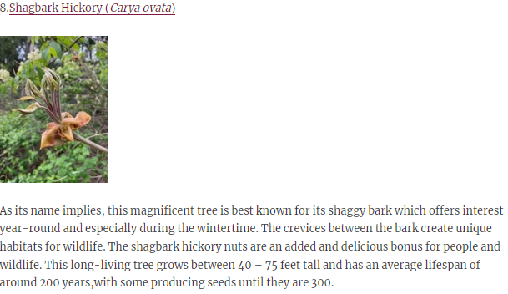
Openlands – 10 Native Trees and Shrubs for Landscaping in the Midwest Link: 10 Native Trees and Shrubs for Landscaping in the Midwest | Openlands

Slide 13
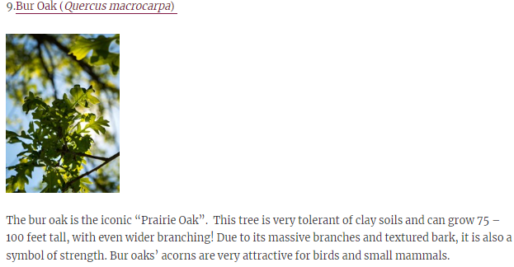
Openlands – 10 Native Trees and Shrubs for Landscaping in the Midwest Link: 10 Native Trees and Shrubs for Landscaping in the Midwest | Openlands

Slide 14
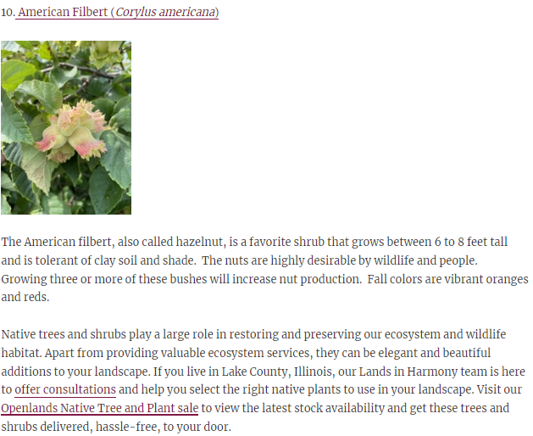
Openlands – 10 Native Trees and Shrubs for Landscaping in the Midwest Link: 10 Native Trees and Shrubs for Landscaping in the Midwest | Openlands

Slide 15
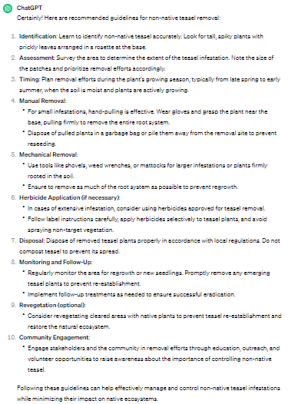
Removing Non-native teasel is important for preserving native ecosystems. Here are some recommended guidelines for non-native teasel removal. Source: Chat GPT

