Slide 1
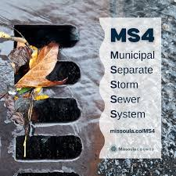
Village of Long grove
Ms4 year 21
Karolina Cho
Gewalt Hamilton Associates
Environmental Consultant

Slide 2
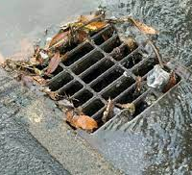
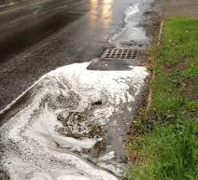
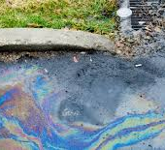
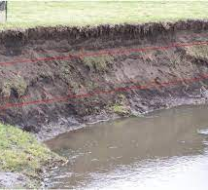
National pollutant discharge detection and elimination (NPDES)
Illicit discharge detection and elimination (IDDE)
Pollution prevention/good housekeeping for municipal operations

Slide 3




Outfall inspections
What we look for:
  Odor
  Color
  Plant growth
  Flow (speed and direction)
Notes:
CMP, RCP w/grate, CMP
13 outfalls

Slide 4
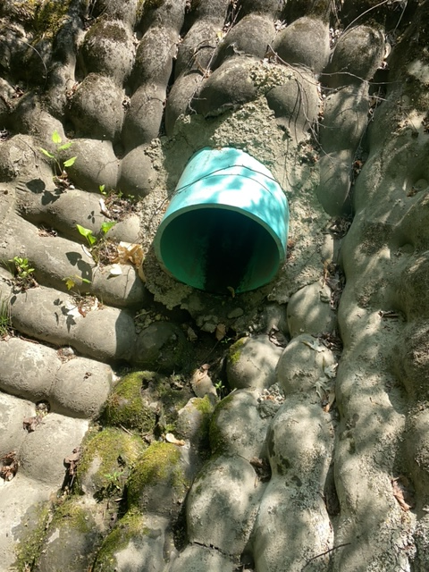
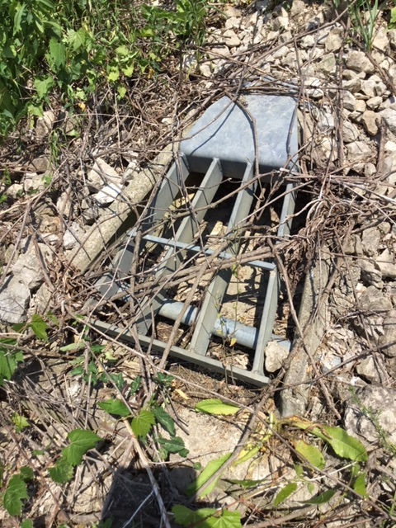
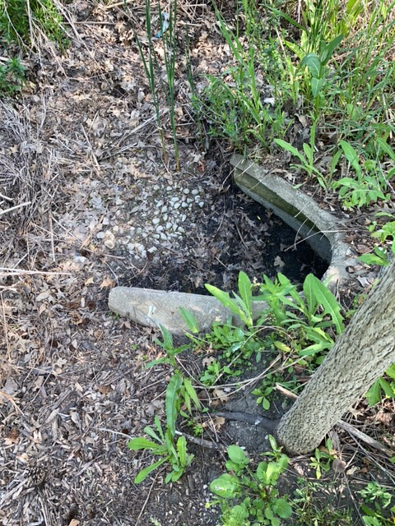
Outfall inspections
Notes:
CMP, RCP w/grate, CMP
13 outfalls
Left photo: Outfall 33 – off of Anderson Ln at Buffalo Creek at Bridgewater Farm
Center: 112 – diamond lake drain between greenbridge lane and daybreak lane
Right: 100 missing grate off wilderness court in royal Melbourne neighborhood

Slide 5
Basins and streambanks
Notes:
Stream at Reed-Turner woodlands near Twin Orchard CC

Slide 6
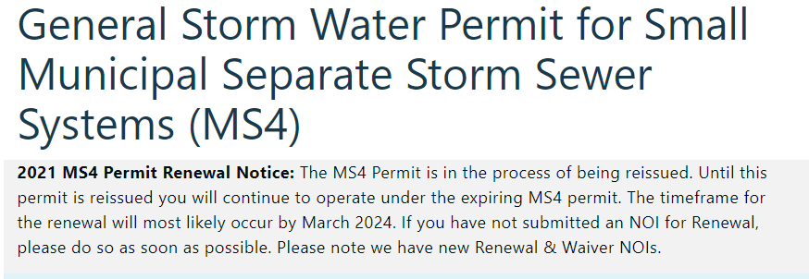
ILR40 Permit Update
Notes:
As of today, the permit is to be released in March

Slide 7
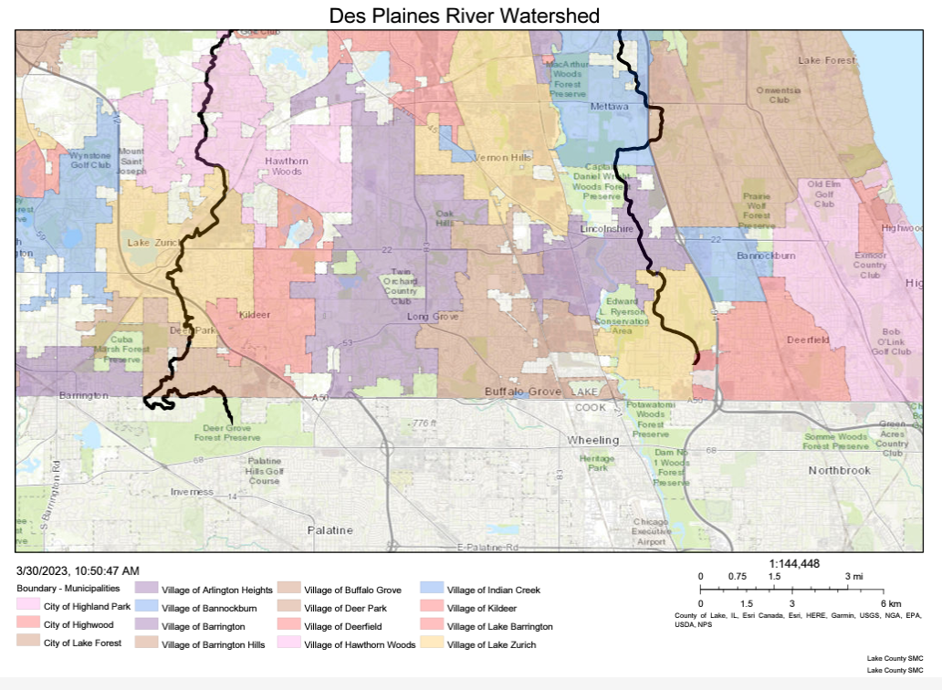
Des Plaines river watershed workgroup narp
POTW total phosphorus reductions beyond 0.5 mg/L have minimal impact on water quality.
Upstream total phosphorus reductions reduce sestonic chlorophyll and improve dissolved oxygen during high flow periods.
Tributary total phosphorus reductions reduce sestonic chlorophyll in the mainstem river, but have minimal impact on dissolved oxygen.
A combined reduction in the load from POTWs, nonpoint sources, and upstream improves the water quality in the Des Plaines River.
Improving upstream dissolved oxygen addresses the impairment in the upper reaches of the Des Plaines River.
The DRWW completed and submitted the Nutrient Assessment & Reduction Plan (NARP) to the Illinois EPA on December 29, 2023.
Notes:
Des Plaines River Watershed Workgroup https://www.drww.org/

